Slide 1
Important Presenter Notes
Please save this file using the Session Code and Title, e.g., “FIN08_BestPracticesWithYearEndClosing”
Slides 1-4 contain presenter notes and are hidden.
Slides 5 and following are slide layouts. Delete any you don’t use.
Include your photo & company logo on your intro slide only (slide 6)
During your introduction, it is appropriate to provide a brief background (1 minute or less) on your organization.

Slide 2
Important Presenter Notes
Attendees love when you submit your slides and reference materials (if using) in advance
Submit your slides and reference materials by Sept. 30 via OneDrive - http://1drv.ms/1U1xUAy
CRMUG will review and edit slides if needed. If edited, CRMUG will email your final slides.
Check out the Speaker Guide for more details!

Slide 3
Quick Best Practices
Frame your presentation by answering:
What do you want your audience to learn?
What do you want your audience to do differently?
What result or outcomes do you want your audience to realize?
Clarify your session objectives up front

Slide 4
Quick Best Practices
Use more pictures, far less words (7 words on a slide is wonderful).
Use varying communication methods and media to increase attention and interaction (e.g., presentation or demonstration, small group discussion, polls, video, etc.)

Slide 5
Session code: DEV03 Extending with XRM Tooling
Mitch Milam, xRM Coaches
Notes:
Title slide to be customized

Slide 6


Introduction – Mitch Milam
Head Coach, xRM Coaches
Independent consultant
Nine–Time Dynamics CRM MVP
Notes:
Introduction slide to be customized. Add intro slide for each panelist.

Slide 7
Session Objectives
Review the components included in the XML Tooling
Notes:
Objectives slide to be customized

Slide 8
Agenda
XRM Tooling Overview
Review the various components
Final Q&A
Closing & Surveys
Notes:
Agenda slide to be customized

Slide 9
overview
Notes:
Example of section slide

Slide 10
Xrm tools overview
WPF Login control
PowerShell support for authentication and connections
Provides thread safety
Supports secure storage of credentials
Provides built-in diagnostics

Slide 11
Who uses it?
Unified Service Desk
Package Deployer
Configuration Migration Tool
And others

Slide 12
Components of xrm tooling
Interface for CRM APIs
Common login control
Web resource utility

Slide 13
Interface for CRM APIs
Low-level interaction and wrapper methods for the CRM APIs
Instrumented API
Thread-safe
Built-in debugging and tracing support

Slide 14
Common login control
A WPF user control that provides a common user interface for the sign in experience to Microsoft Dynamics CRM
Supports all the authentication modes, except Oauth
Built-in encryption for securely storing your credentials

Slide 15
Web resource utility
Provides support for accessing web resources of the types:
Image
XML
Images are returned as a WPF BitmapImage
XML is returned as a string

Slide 16
Using Xrm tooling for Connecting to CRM
Connect to CRM using an existing OrganizationServiceProxy object
Connect to:
CRM Online (Live ID)
CRM Online (Office 365)
CRM on-premises (Active Directory)
CRM Internet-facing deployment (IFD)
CRM (Claims-based)

Slide 17
Sample: Connect to crm using office 365
CrmServiceClient crmSvc = new CrmServiceClient(
"<UserName>",
"<Password>",
"<CRMonlineRegion>",
"<OrgName>",
isOffice365:true);

Slide 18
The powershell cmdlets
Get-CrmConnection
Connects to CRM given a value URL and credentials
Get-CrmOrganizations
Returns a list of CRM organizations available to the user

Slide 19
Microsoft.Xrm.Tooling.Connector Namespace

Slide 20
classes
AttributeData
BatchItemOrganizationRequest
BooleanAttributeData
CrmDataTypeWrapper
crmMessageInspector
CrmServiceClient
CrmFilterConditionItem
CrmSearchFilter
ImportFileItem
ImportRequest
PickListItem
PickListMetaElement
DeviceIdManager
DeviceRegistrationAuthentication
DeviceRegistrationClientInfo
DeviceRegistrationFailedException
DeviceRegistrationRequest
DeviceRegistrationResponse
DeviceRegistrationResponseError
DeviceUserName
DynamicsFileLogTraceListener
LiveDevice
PicklistAttributeData
RequestBatch
StringAttributeData
TraceControlSettings
Utilities
XmlUtil

Slide 21
Enumerations
Enumeration
AuthenticationType
BatchStatus
CrmFieldType
FormTypeId
DataDelimiterCode
FieldDelimiterCode
FileTypeCode
ImportMode
ImportStatus
LogicalSearchOperator
LogicalSortOrder
DeviceRegistrationErrorCode

Slide 22
CrmServiceClient

Slide 23
CrmServiceClient properties
ConnectedOrgFriendlyName
ConnectedOrgPublishedEndpoints
ConnectedOrgUniqueName
ConnectedOrgVersion
ConnectionLockObject
CrmConnectOrgUriActual
IsBatchOperationsAvailable
IsReady
LastCrmError
LastCrmException
OrganizationServiceProxy

Slide 24
CrmServiceClient Methods
AddEntityToQueue
AssignEntityToUser
CancelSalesOrder
CloseActivity
CloseIncident
CloseOpportunity
CloseQuote
CloseTroubleTicket
CreateAnnotation
CreateBatchOperationRequest
CreateEntityAssociation
CreateMultiEntityAssociation
CreateNewActivityEntry
CreateNewRecord
CreateOrUpdatePickListElement
DeleteEntity
DeleteEntityAssociation
DiscoverOrganizations
ExecuteBatch
ExecuteCrmEntityDeleteRequest
ExecuteCrmOrganizationRequest
ExecuteWorkflowOnEntity
GetActivitiesBy
GetAllAttributesForEntity
GetAllEntityMetadata
GetBatchById
GetBatchOperationIdRequestByName
GetBatchRequestAtPosition
GetDataByKeyFromResultsSet
GetEntityAttributeMetadataForAttribute
GetEntityDataByFetchSearch
GetEntityDataByFetchSearchEC
GetEntityDataById
GetEntityDataByLinkedSearch
GetEntityDataByRollup
GetEntityDataBySearchParams
GetEntityDisplayName
GetEntityDisplayNamePlural
GetEntityFormIdListByType
GetEntityMetadata
GetEntityName
GetEntityTypeCode
GetGlobalOptionSetMetadata
GetHashCode
GetMyCrmUserId
GetPickListElementFromMetadataEntity
ImportDataMapToCrm
ImportSolutionToCrm
InstallSampleDataToCrm
IsSampleDataInstalled
MakeSecureString
PublishEntity
ReleaseBatchInfoById
ResetLocalMetadataCache
RetrieveBatchResponse
SendSingleEmail
SubmitImportRequest
UninstallSampleDataFromCrm
UpdateEntity
UpdateStateAndStatusForEntity

Slide 25
Working with classes generated by the code-generation tool
The Microsoft.Xrm.Tooling.Connector assembly doesn’t directly provide interfaces for the entity and data context classes generated using the code-generation tool
You can use CRM connection created by the CrmServiceClient class to set up your entity and data context classes

Slide 26
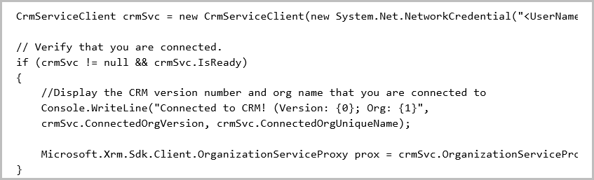
Sample: Crmserviceclient.organizationserciceProxy

Slide 27
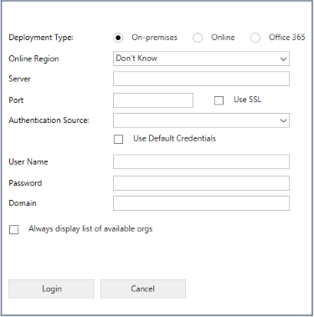
Using the login control

Slide 28
Prerequisites
.NET Framework 4.5.2
Microsoft Visual Studio 2012 or Visual Studio 2013
Nuget Package Manager for Visual Studio 2012 or Visual Studio 2013
Microsoft Dynamics CRM SDK templates for Visual Studio that contains the common login control template

Slide 29
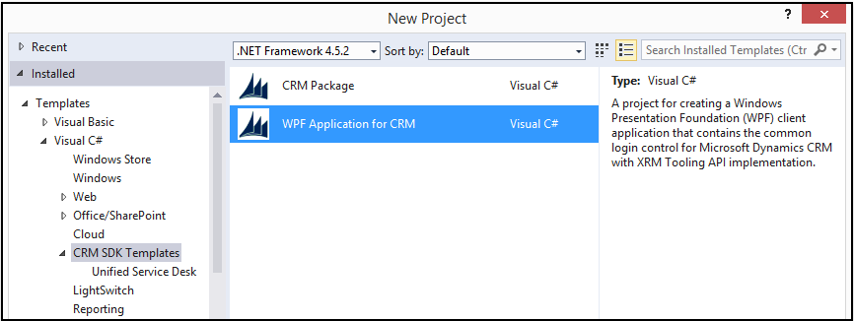
Creating a new WPF Application

Slide 30
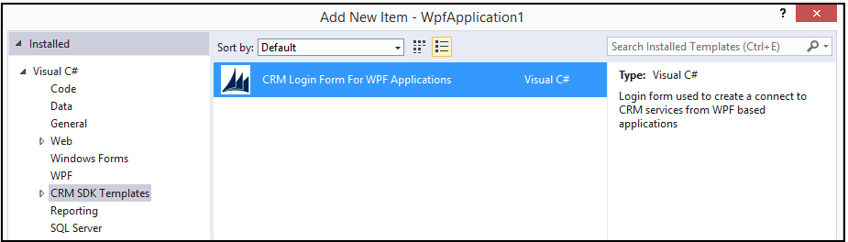
Add to an existing wpf application

Slide 31
Using xrm tooling diagnostics
Can record data related to process milestones across all components of XRM tooling, such as:
Operation calls
Warnings
Exceptions
Other significant events
Tracing in XRM tooling is built on top of System.Tracing

Slide 32
Trace listeners
Can record to:
Console
File system (text file)
Windows Event Log

Slide 33
Trace levels
Possible values for switches:
Off
Error
Warning
Info
Verbose

Slide 34
Trace level detail
Verbose includes:
Error, Warning, Info, Trace levels
Info includes:
Error, Warning, Info levels
Warning includes:
Error, Warning levels
Error includes:
Error level

Slide 35
Questions?

Slide 36
Contact Info
Mitch Milam, xRM Coaches
Email: mitch@xrmcoaches
Blog: Infinite–x.net
Twitter: @mitchmilam
Notes:
Add presenter contact info (no logos or images)

Slide 37
Thank you!
Please complete & turn in your survey now
Visit the online CRMUG Summit 2015 community to download these slides, ask questions, and connect with participants
Visit the CRMUG Medics in the HUB to get expert advice on your CRM-related problems!
Notes:
Thank you slide

Slide 38
Notes:
Final slide

